Slide 1
Java Spark API

Slide 2
RDD: Resilient Distributed Dataset
dataset: Collection of data, list of sting, integer
RDD what can we do?
transformation: apply function to crate new RDD : filter,map. Instead of mutating existing RDD

Slide 3
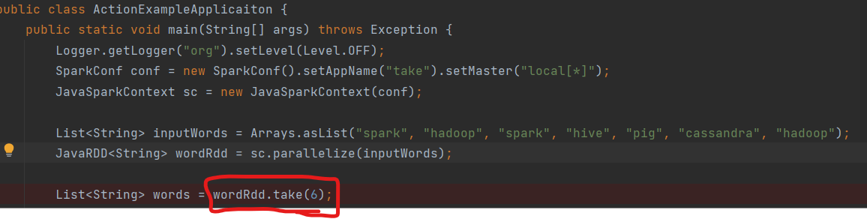
Action in Spark
compute result based onRDD
first(), collect()

Slide 4
Action is lazy like terminal operation in stream
Only computed in lazy fashion
2nd type of operation
Return final value to driver program or persist data to external storage system
collection: retrieve entire RDD => return into collection or value, shouldnt use with large data set, only for smol data set
count: count rows in RDD
countByValue: count unique values of each row and return Map<String, Long>

Slide 5
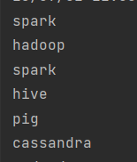
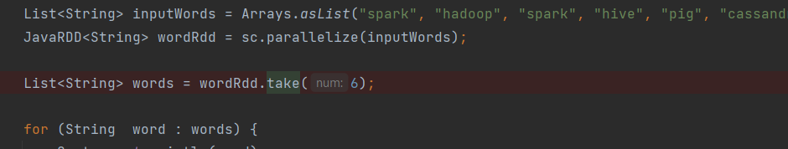
take() in action
List<String> take(int n): takes n eleemnt from an RDD:
take a peek at RDD for debug or unit test
take return n element and try to reduce number of partition it access => may not return order expected

Slide 6
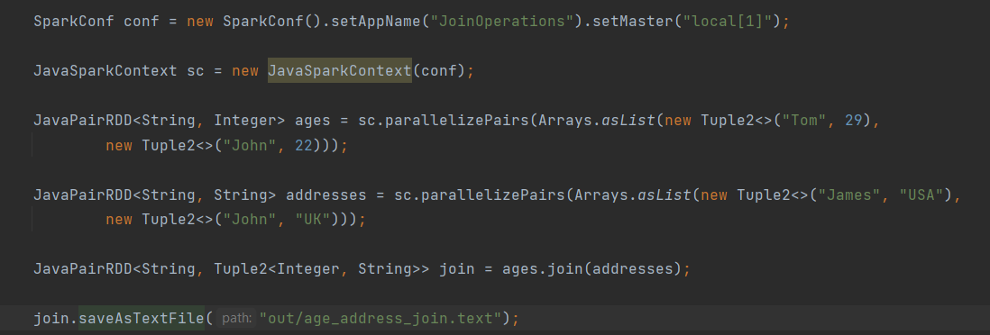
save()
void saveAsTextFIle can be used to write data out to HDFS or Amazon S3, or local

Slide 7
reduce()
Operate on 2 element, return new element, reduce to single value
Type is same with input

Slide 8
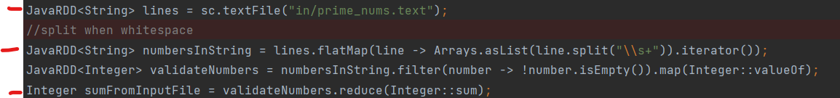
Spark Workflow
generate initials RDDs from external data
apply transformation
launch actions

Slide 9
How to create RDDs
2 ways to create RDD
1: reading from existing collection
List<Integer> inputNums = Arrays.asList(1, 2, 3, 4, 5, 6, 7);
JavaRDD<Integer> numsRdd = sc.parallelize(inputNums);
=> not efficient because collection dattaset must fit into memory of driver machine: parallelLine()
2: loads form external storage: textfile()
JavaRDD<String> lines = sc.textFile("in/prime_nums.text");

Slide 10
Transformation:
Return new RDD like how in Java 8 Stream API intermediate operation return new Stream
filter(): takes in a functions returns an RDD formed by selecting those element
map(): pass each element in the input RDD => result of function being new value of each element in the result RDD
flatMap(): 1 to many relationship, produce many element from 1 input
Or many to 1 relationship, a stream of multiple list can be flattening out

Slide 11
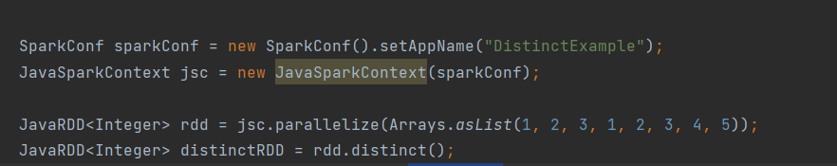
distinct():
returns distinct rows form input RDD
=> shuffling all data to ensure only 1 copy of each element

Slide 12
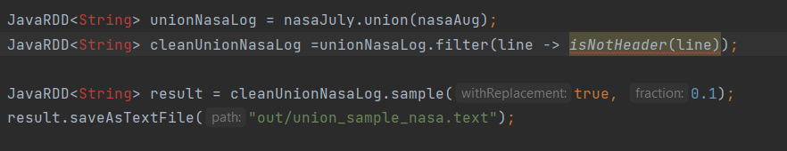
Set operations
sample(boolean withReplacement, double fraction)
withReplacement - can elements be sampled multiple times (replaced when sampled out)
0.1 for 1/10th of orignal data set
useful for testing purpose
create random sample from RDD

Slide 13
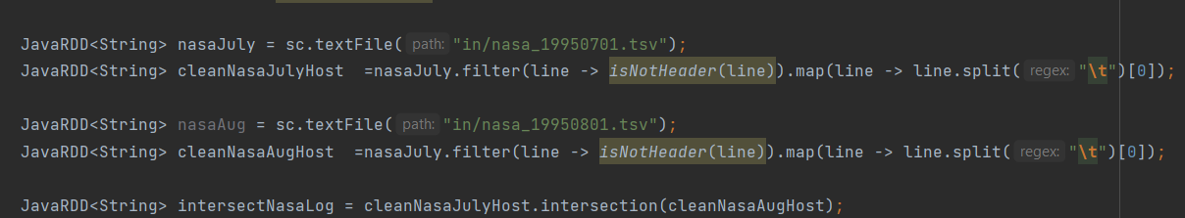
Set operations perform on 2 RDDs to result into 1 RDDs
union(): give back RDD onsiting of both input RDD
intersection: returns common elemnt appear in both input RDDs
intersection: expensive => shuffing all data

Slide 14
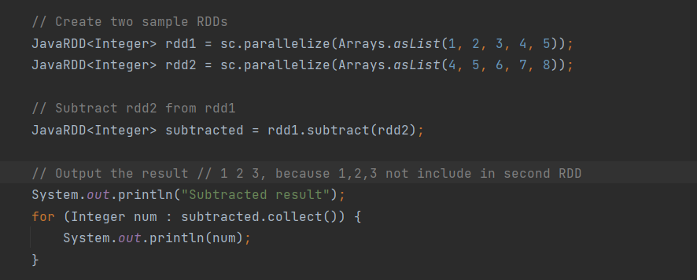
subtract()
subtract: takes in another RDDs and turn an RDDs that only include the first RDDs but excluded RDD
expensive => shuffling all data

Slide 15
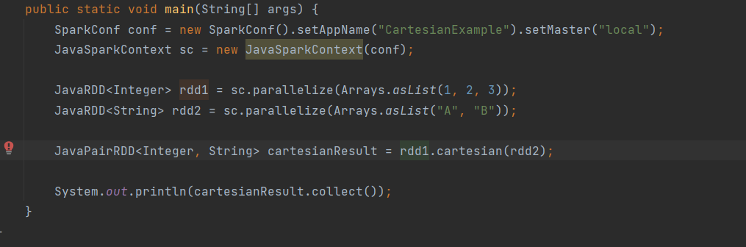
Cartasian:
Cartasian: returns possible pair of a and b (Cartisian product)
=> handy if want to compare similarity between all possible pairs

Slide 16
IMPORTANT ASPECT OF RDDS

Slide 17
RDDS ARE DISTRIBUTED
Broken into partitions, divided across cluster
partitioning is done by Spark
Immutable => dataset can’t be change once created like Stream to rule out problem when updating multiple threads at once

Slide 18
RDDs are resilient
deterministic function => same input = always same output like sum x+y
if node of cluster goes down, Spark can recover part of RDDs from input and pick up where left off

Slide 19
Lazy evaluation
spark will not begin to execute or Data processing until see an action
data action: collect, count, saveAsTextFIle
data proccesing: mean computation and data movement

Slide 20
Demonstrating why Spark is Lazy
Spark consisting of instruction on how to compute data rather than contian data
JavaRDD<String> lines = sc.textFile: nothing happen here
JavaRDD<String> lineswithFriday = lines.filter(line -> line.startwith "Friday) // nothing happen
String fristLineWithFriday = linesWithFriday.first(2) // sparking start loading sc.textfile when first() is called
first(); => spark can first line starting with Friday then stop => not go entire FILE

Slide 21
Persistence
Why:
when call actions on same RDD
expensive for iterative algorithm
=> reuse RDD with persist()

Slide 22
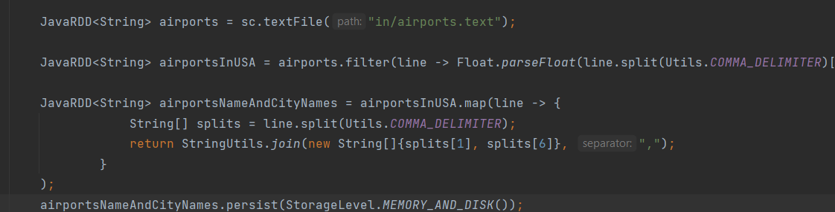
persist()
Use on JavaRDD

Slide 23
When i call persist: parallelize is performed and distribute the RDD from driver program to all worker thread
since RDD is persistsed, parallelize() dont need to be performed again
=> can reuse airportsNameAndCityNames

Slide 24
Type of Persist
MEMORY_AND_DISK: deserialize Java object. If RDD is not fit in memory => store in Disk
MEMORY_ONLY_SERR store as serialize java object
Serialized storage is more space-efficient, which might allow you to cache more data than if using the default storage.
Cause CPU overhead due to serialization
if the dataset doesn't fit entirely in memory, partitions that aren't stored will be recomputed when they are needed. This re-computation can introduce delays, especially if the dataset's generation process is time-consuming.
MEMORY_AND_DISK_SER: similar to MEMORY_ONLY_SER
Reading deserialized data from memory can be faster than re-computing the data, but it might be slower than reading non-serialized data.
If dataset doesn’t fit in memory, store in disk
DISK_ONLY: RDD partition store on disk
on the fly: run time while application is running-

Slide 25
When to use these type?
depend on trade off between memory space and CPU efficient
dont save to disk unless function computed dataset are expensive, or filter signnificant amount of data
if cache too much data to fit in memory
Evoke old partition with LEAST RECENTLY USED policy
MEMORY_ONLY recompute partition when needed
MEMORY_AND_DISK: write partition to disk
=> SPARK job wont break if cache too much data
caching unuseful data => evict older userful data

Slide 26
Architecture

Slide 27
Master slave architecture
1 master node and many workers node
Masternode:
have driver program, drives application, if use shell => shell is driver program
Create sparkContext: gateway to all spark functionality
works with cluster manager do manage various job
each driver program execution = job => drive program converts job to task and split it to be executed by spark executor
Executor
are workload processes in charge of running individual task in a given spark
Launch at the beginning spark application and last for entire time
once run task => send result to driver
Driver
access park through spark context
control and coordinate all operation on RDD

Slide 28
Spark Component
Spark SQL: sql style abstraction
spark streaming: manipulating data stream closely match spark core RDD
Enable powerful interactive and analytical application across both streaming and historical data
MLlib:
scalable machine learning deliver high quality algorithm
consist of common learning algorithm: regression, dimensional reduction...
GraphX: create transform graph structure data
Multigraph

Slide 29
Who use Spark
data sciens: identify pattern, trend, risk and opportunities
analyze data with goal of answering a question
supporting entire data science workflow => machine learning
data processing application engineer
partner with data scientist

Slide 30
Pair RDDs:

Slide 31
a lot of data sets: key value pairs
store key value pairs

Slide 32
Create Pair RDDs: 1st approach Tuple
Tuples
Tuple2<Integer, String> tuple = new Tuple2<>(12, "value);
Integer key = tuple._1();
String value = tuple._2();
in Spark context 1 is key, 2 is value

Slide 33
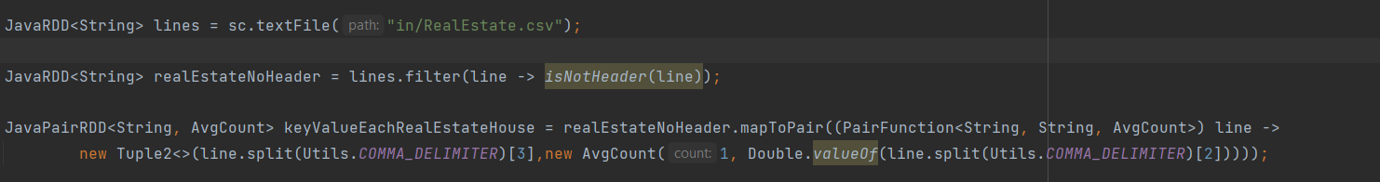
2nd approach: mapToPair
mapToPair()
implement PairFunction
return (PairFunction<String,String,String) -> Tuple2<>(... , ...);

Slide 34
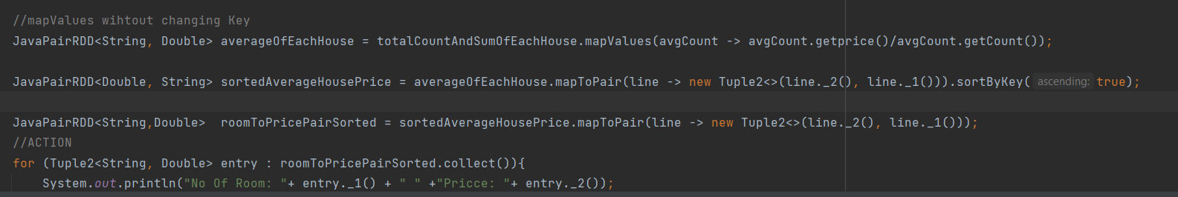

Slide 35
Aggregation
reduceByKey
sing reduceByKey NOT to return a value to program, but return new RDD consist of each key with the reduced value

Slide 36
reduceByKey() vs countByValue()
countByValue: produce map in driver program to calculate number of occurance, its an action in RDD=> implement with reduce, ->DRIVER collect partial result and merge itself => good for small data set
reduceByKey: shuffles key to different execution and does reduce in every worker => good for larger data set
reduceByKey phase
1st phase pairs on PARTITION is combined with reduce() before data shuffled
2nd phase: reduce all the values from each partition to produce final key result

Slide 37
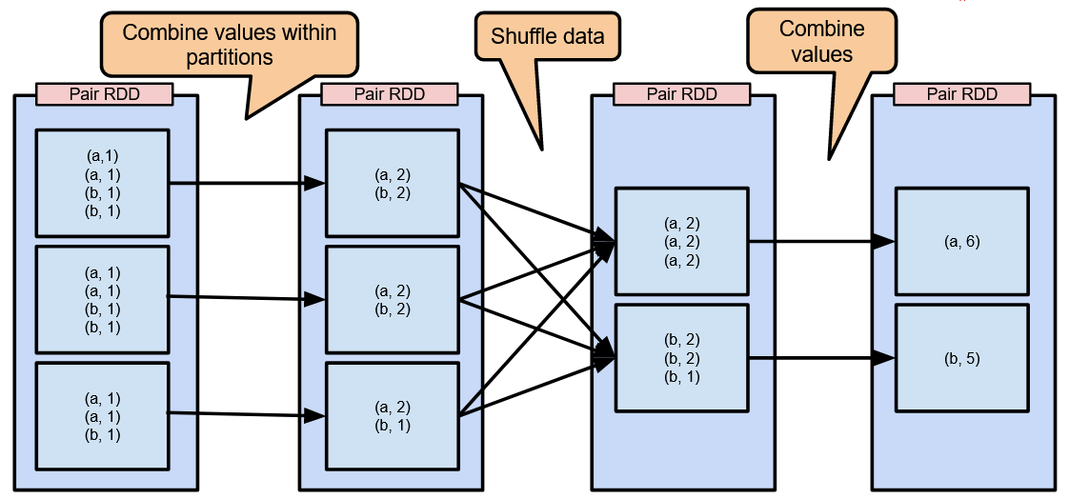
reduceByKey visualize
Combine then shuffle then reduce

Slide 38
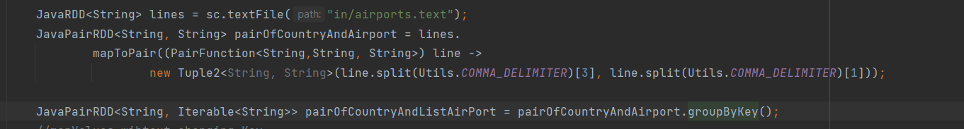
groupByKey: return JavaPairRDD<K>, Iteratable<V)
groupByKey: return JavaPairRDD<K>, Iteratable<V)

Slide 39
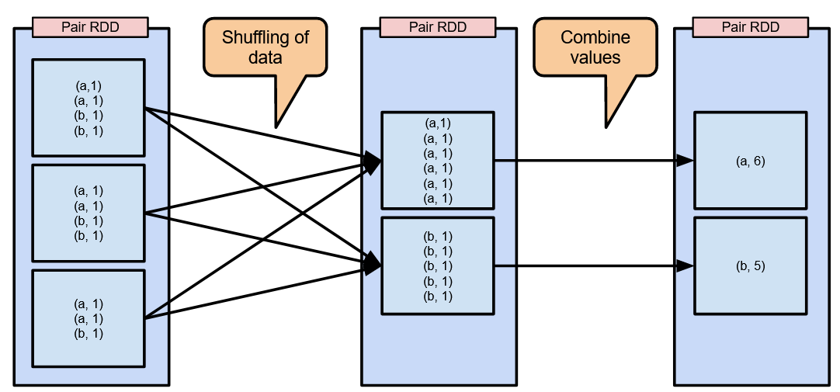
groupByKey vs reduceByKey
groupByKey phase
1st: data is shuffled around => large data is transfer across the wire (can fix with partitioning)
2nd phase: reduce all value

Slide 40
SortByKey

Slide 41
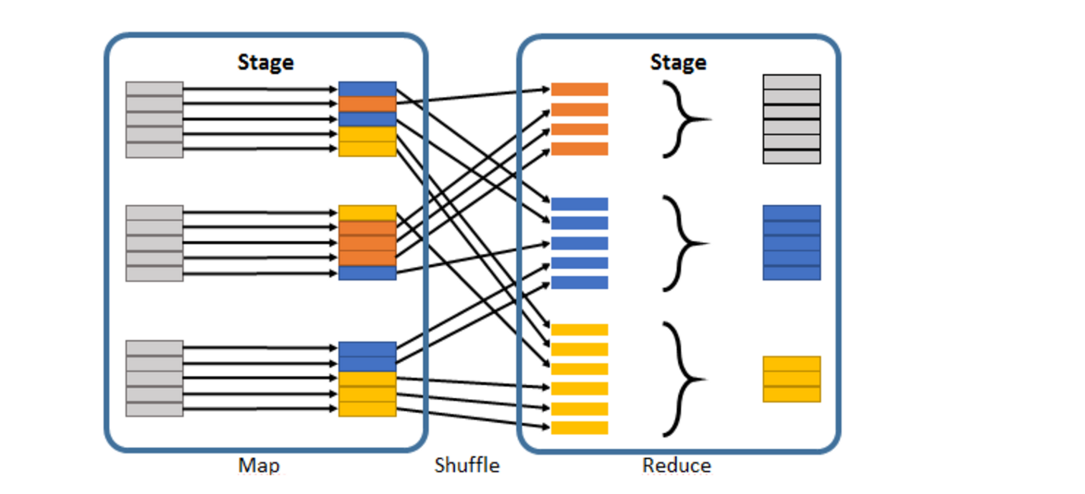
PARTITIONING
to reduce amount of shuffle in groupByKey
return copy of PairRDD
Hash Paritition and RDD into 4 parition, so key have same hash value 4 appear on same node
=> call ParitionBy, data wont be randomly shuffled,same key on same Node
=> shuffle data once
=> remember to .persist result of persist or else repeat paritioning
JavaPairRDD<String, Integer> partitionedRDD = pairRDD.partitionBy(newHashPartitioner(4))
paritionedRDD.persist(StorageLevel.DISK_ONLY));
paritionedRDD.groupByKey

Slide 42
Benefit of partitioning
groupbyKey, join, left join, reduceByKey
reduceBykEY on pre-partition RDD: ALL Value from each key computed locally on a single machine =>
reduced value will be sent from worker node to master

Slide 43
Affected by partitioning
map: cause new RDD to forget parent paritioning information => change key of each elemnt
=> result not have partitioner
how to avoid: mapValues each tuples key remain the same => use this over map

Slide 44
JOIN OPERATION
Join Operation: operation most commonly use
Inner Join: take same pair of key : JavaPairRDD(String, Tuple2<..., ...>)
Left + Full + Right Join: join together by key while of pair RDD can be missing Key
Resulting: tuple value of source and Optional value for the other pair RDD
Left: JavaPairRDD<String, Tuple2<..., OPTIONAL <...>>>
Right JavaPairRDD<String, Tuple2<OTIONAL<>, ...>>
FULL OUTER JOIN: JavaPairRDD<String, Tuple2<Optional, Optional>

Slide 45
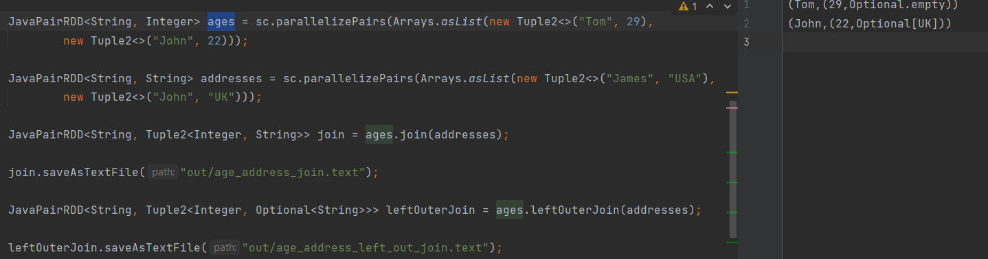

Slide 46
if both RDD have duplicate key
will expand size of data, perform distinct or combineByKey to reduce Key space
require large network transfer
expensive since require corresponding keys from each RDDs loacated at same partition to be combined locally
If RDDs do not have known partitioners, they shuffled so both RDDs share a partitioner and data
with same keys lives in same partition

Slide 47
Shuffle Hash join
it shuffles the smaller DataFrame or RDD and creates a hash table out of it. Then, it streams the larger DataFrame or RDD, and for each row, it probes the hash table to find matching rows.
To join data, Spark need data to be joined live in same partition
Shuffled Hash Join is particularly suitable when:
One of the DataFrames or RDDs is significantly smaller than the other, so that it can be effectively broadcasted across nodes and fit in memory.
The join keys have a high cardinality, meaning there are many unique keys. This ensures the in-memory hash table is utilized effectively.

Slide 48
Dont use when
Memory Constraints: If the smaller DataFrame or RDD is not small enough to fit into memory, then this can lead to out-of-memory issues. It's crucial to ensure that the dataset used to build the hash table can fit comfortably in the available memory.
Not Optimal for Large-Large Joins: If both DataFrames or RDDs are large, then a different strategy, like Sort Merge Join, might be more efficient.
shuffle can be avoided if both RDDs have known partitioner
recommend to call partitionBy on the two join RDD with same partitioner before joining them
val partitioner = new HashPartioner(20)
ages.partitionBy(partitioner)
address.partitionBy(partitioner)

Slide 49
ADVANCE TOPIC

Slide 50
Accumulators
Accumulators: variables that are used for aggregating information across the executors
=> example calculate record that are corrupted for debugging purpose
Accumulator = register(1,2,3)
1:sparkcontext
2: human readable name show in spark UI
3: accumulate value from failed task: set true for time, false for absolute value

Slide 51
Step to create accumulator
girst create SparkConf => SparkContext => JavaSparkContext
LongAccumulator = new LongAccumulator
total.registe(sparkContext, Option.apply, false)
task on worker nodes cant access accumulator value (driver only one to do this)
accumulators are write only => implemented efficiently, without having to communicate every update

Slide 52
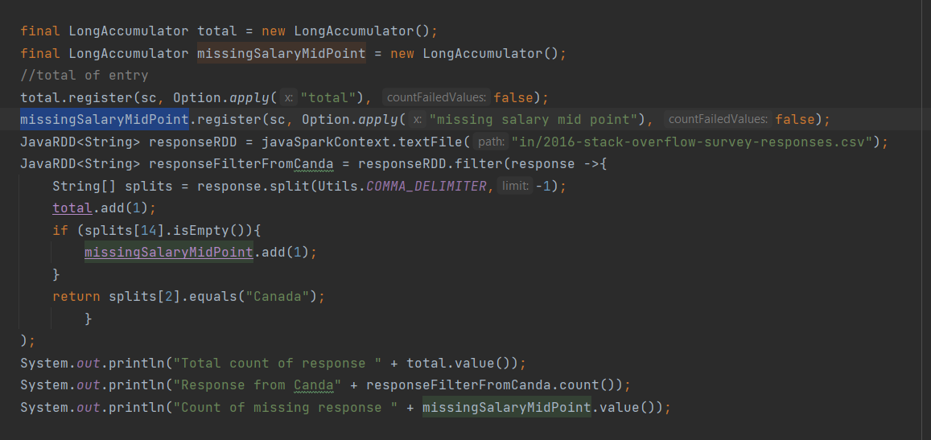

Slide 53
Alternative way to use
can use reduceByKey instead of accumulators or reduce

Slide 54
Broadcast variable
broadcast variable: variable share through cluster
allow to keep read-only variable cached on each machine rather than shipping a copy of it for task
available on all nodes in a cluster in order to be accessed used by task
example: CA : california, NY: New York by doing look up to a reference mapping
WHY:
since distributing information with each task over network is time consuming

Slide 55
Procedure
create Broadcast variable T
SparkContext.broadcast(Object T)
Use custom java object if it implement Serializable
Treated as read only

Slide 56
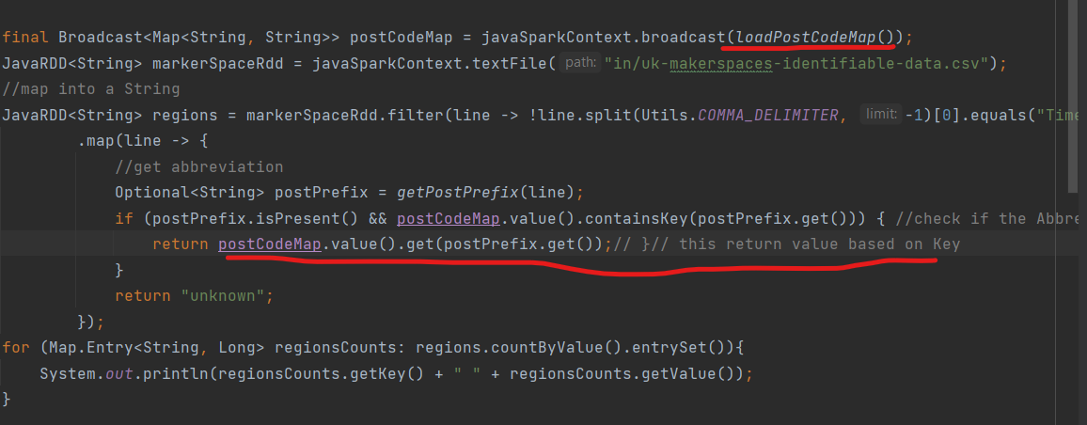
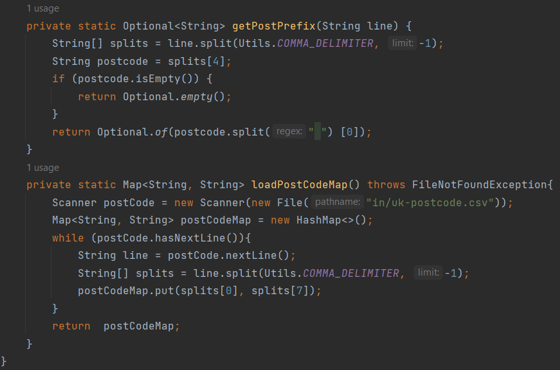
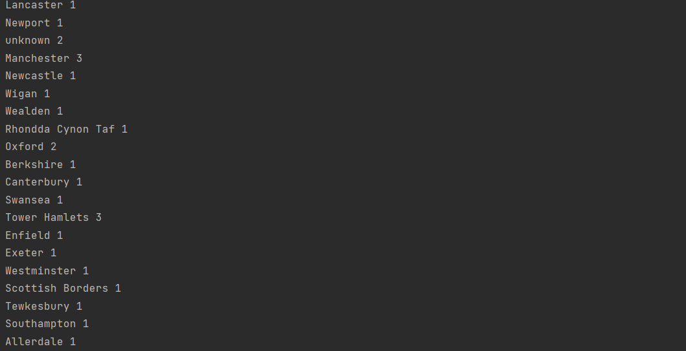

Slide 57
Problem of not using Broadcast
Lets say if we just use map
send all variables reference in closure to worker node
convenient but inefficient because default task launching mechanism is optimized for small task size
*** if use parallel operation, spark send separately for each operation
=> performance issue
*** if larger Map => expensive to send transfer data
*** if reuse postcode Map => need to be sent again

Slide 58
Spark SQL
structured data has schema, known set of fields for each record
provides a dataset abstraction simplifies working with structured datasets, sim
dataset similar to table in relational database
more spark workflow moving towards Spark SQLto deal with structured data

Slide 59
DataFrame
DataFrame: data abstraction or a domain-specific language for working with structured nd semi-structured data
Data Frame store data more efficient than native RDD, taking advantage of schema
use immutable, in-memory. resilient, distributed and parallel capabilities of RDD
applies schema to data, allowing Spark to manage schema and only pass data between node
on much more efficient way than using Java serialization
Unlike rDD, data is organized into named COLUMNS like table in RELAITONAL DAtABASE

Slide 60
DataSet
familiar object-oriented programming style
compile type safety
benefits of leveraging schema to work with structured data
Spark 2.0 DataFrame Apis Merge with Dataset APIs.
Dataset takes on 2 distinct APIs characteristic: strongly typed APi and untyped API
DataFrame as untyped view of Dataset, which is a Dataset of Row where a Row is generic untyped JVM Object
Dataset, by contrast, is a collection of strongly-typed JVM object

Slide 61
Untyped vs Strongly typed
Untyped: type known during run time
Strongly: type known during compile time

Slide 62
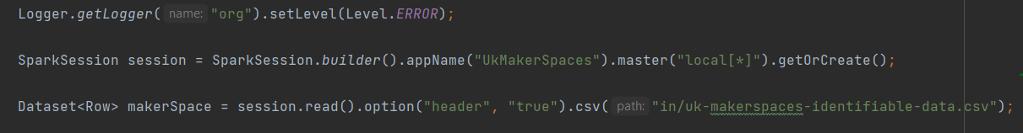
Procedure
Step
1. create SparkSession for SparkSQL provided single point of entry
internally use SparkContext
follow Builder pattern
DataFrameReader spark interface load dataset from external dataset
2. Dataset<Row>option("header", "true": header is not data
.csv: load from csv from local disk
dataset is a distributed collection of tabular data organized into rows

Slide 63
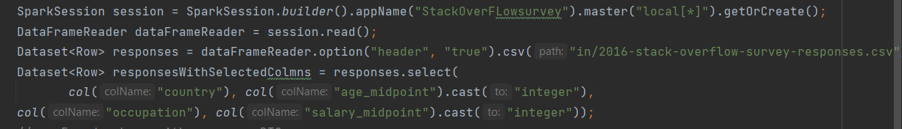
1 row map = 1 line
Easy to use, readbility

Slide 64
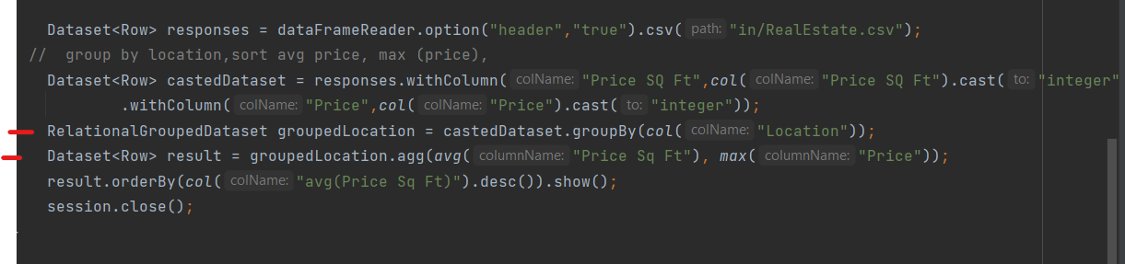
groupBy() then max min, sum, or count

Slide 65
Catalyst Optimizer
SparkSQL use to optimize all queries written both in Spark SQL and DataFrame SQL
=> run faster than RDD
A modular library which built as a Rule-based system
Each rule in framework focuses on the specific optimization

Slide 66
Downside of SparkSQL
give up some contro
SparkSQL can push down or re-order operations to make the joins more efficient
dont have control over PARTITIONER for Datasets
so cant manually avoid shuffle compare to Core Spark

Slide 67
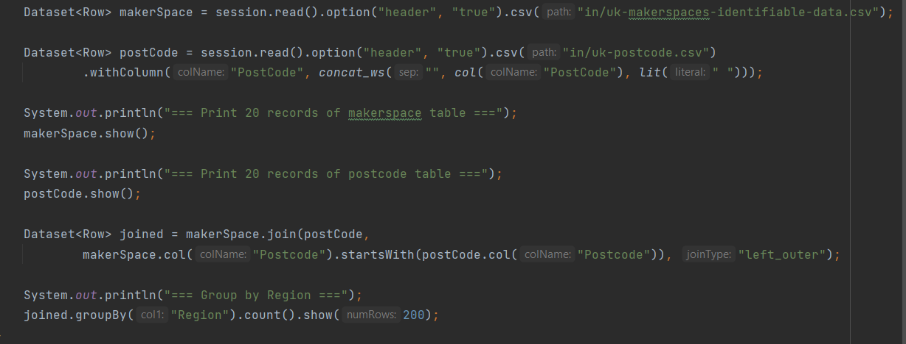
SparkSQL Join
SparkSQl support same basic joint like core SPark (RDD)
SparkSQL Catalyst optimizer can do more heavy lifting

Slide 68
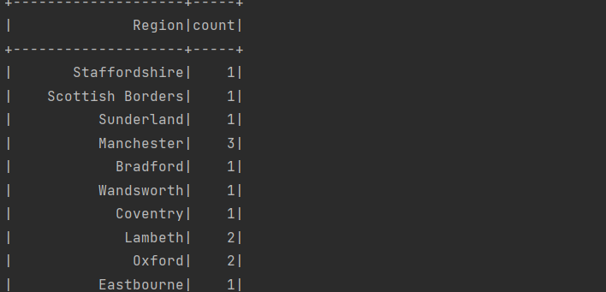

Slide 69
STRONGLY TYPED DATASET
stronly typed that can be transformed in parallel using functional or relational operation
Dataset<Row> = DataFrame
Rows: records inside datasets simply fixed length array of field
Rows has .get() to obtain value of each field
take a column number and return object type (we cast it on our own)

Slide 70
Why
getLong() to return long
getBoolean() to return boolean ....
=> strongly typed dataset to avoid weak type error
Object field7 = .get(7) vs
Long field7 = .get(7)

Slide 71
Encoder
translate between JVM respresentation or (JAVA OBJECT) and SPark internal binary format
built in encoder:
Integer or Long encoder, advanced in that they generate bytecode to interact with off - heap data and provide on demand access to individual attributes without having to de serialize an entire Object

Slide 72
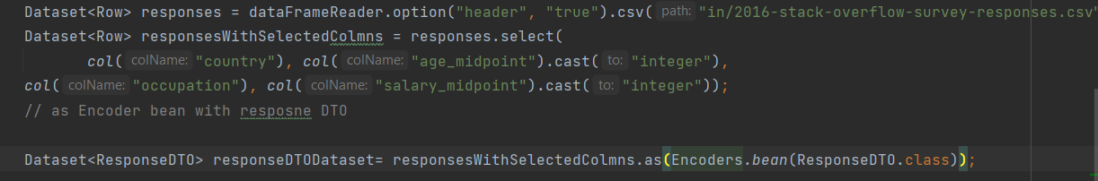
In ResponseDTO class
supported primitive (int, long) and boxed(Integer, Long)
*** not support Optional field and map
*** must have zero argument constructor and all field with setter

Slide 73
DataSet Or RDD
DATASET
Since Spark 1.6
Spark streaming moving toward structured streaming, heavily based on Dataset API

Slide 74
RDD
RDD is primary user facing API in spark
immutable, distributed collection of element of data, partitioned across nodes in cluster operated parallel
use when
low-level transformation, action, and control on dataset
unstructured data, media stream or stream of text
manipulate with data using functional programming

Slide 75
Dataset
Rich semantics(able to express operation like grouping, filtering with easier-simpler - understandable code), high level abstraction,
processing using aggregate function, avg, sum, sql queries on semi structured data
Higher degree of strong type at compile time
Use if possible since if possible better performance, using SQL

Slide 76
NOTED
RDD is fundamental building block of Dataset

Slide 77
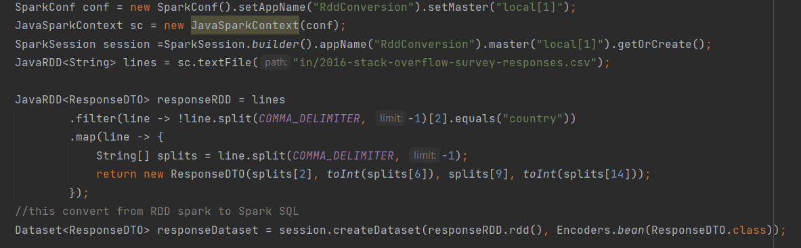
CONVERSION BETWEEN DATASET and RDD
Convert RDD to Spark

Slide 78
TUNE THE SPAKR SQL performance
Caching dataset
responseDataset.cache(), similar to cache Spark RDD
use in memory columnar storage for dataset
minimize the data read, automatically tune compression

Slide 79
spark.sql.codegen
SarkSession session = SparkSession.builder().config(spark.sql.codegen, fail).getOrCreate()
=> compile each query to java bytecode before executing it
=> make long or repeated query faster since Spark generate specific code to run
shouldnt use for short or non repeated query since cause uncessary overhead as SPark has to run a complier for each query
Similar to Interpreter vs JIT Complier in JDK

Slide 80
spark.sql.inMemoryColumnarsStorage.batchSize",10000
default batch size is 1000
caching a dataset, spark group together record in batches of size given by option and compresses each batch
larger batch size => improve memory utilization and compression
batch with large number of records might be hard to build up in memory and can lead to OUtOfMemory
(row has many field or column) => small batch size since a row batch column can occupy many memory
idea is to storing data in column wise rather than row wise
more efficient when perform on column filtering or aggregation

Slide 81
RUN IN CLUSTER MODE
Cluster Manager: Master node
Spark COntext acquire executor in cluster
cluster manager pluggable component
hadoop
yarn
Apache Mesos

Slide 82
PACKAGE APPLICATION THEN
RUN SPARK APPLICATION USE SPARK-submit
spark submit com.package.ClassName /target/File.jar

